Slide 1






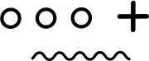
Interacting with Tiny bit
Android bluetooth APP control
Yahboom

Slide 2








Contents
Download code
Download APP
Connect bluetooth
About APP
Yahboom

Slide 3
Download code
! Note: We provide two hex files,
microbit-Buletooth_control.hex without ultrasonic display function,
The microbit-Bluetooth_control_with_Ultrasonic.hex is shown with an ultrasound display.
It is recommended that you use the former (without ultrasound display, the control is smoother)
Yahboom

Slide 4
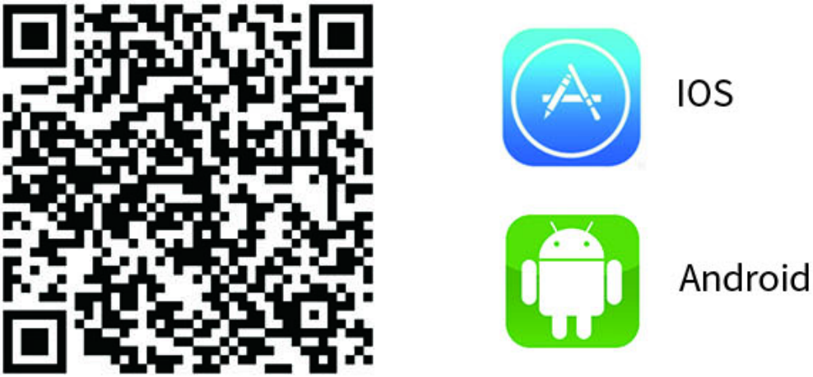
Download APP
Android users please use the browser to scan the following QR code to download and install or download the 【Android Remote APP】 provided by us directly in the download area;
Yahboom

Slide 5
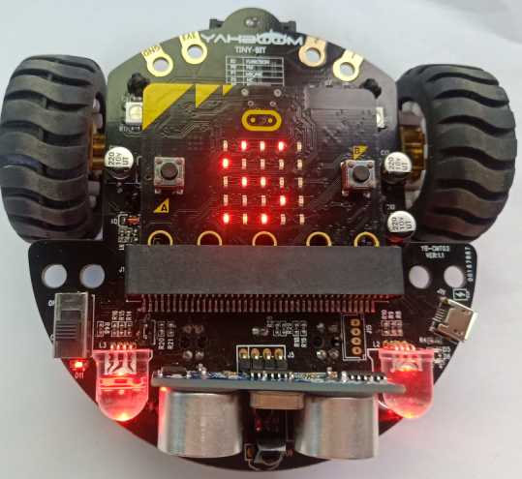
Connect bluetooth
3.1After downloading the Bluetooth remote control APP, we have to install it.
(Note: If the phone prompts you to obtain location rights during installation, you need to click to “agree” to get location permissions.)
3.2After the Bluetooth remote control code is downloaded, open the power of the Tiny-bit. At this point, you will see the pattern shown in Figure 3-1 on the LED dot matrix of the micro:bit board. The RGB light will be lighted up in red. It is the state that Bluetooth is not connected.
Figure 3-1
Yahboom

Slide 6
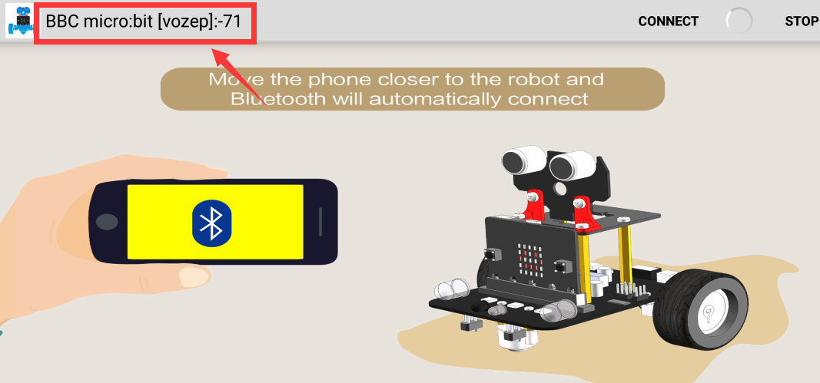
Connect bluetooth
3.3 Open the bluetooth of your phone,open the Bluetooth APP. You will see the Bluetooth signal in the upper left corner of the Bluetooth APP interface, as shown below.
Figure 3-2
Yahboom

Slide 7
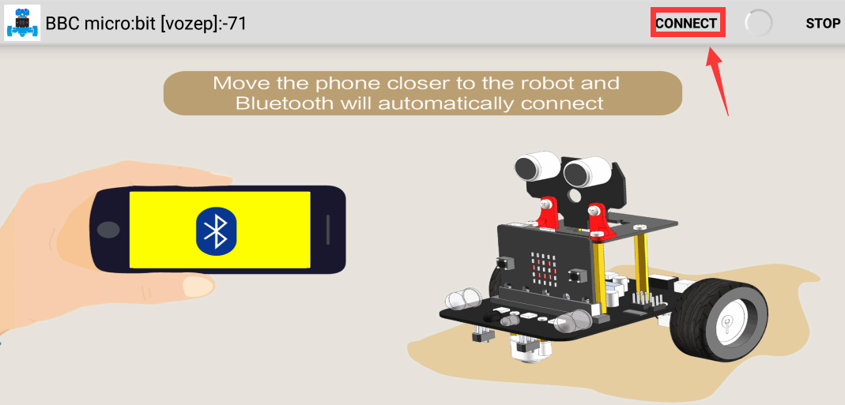
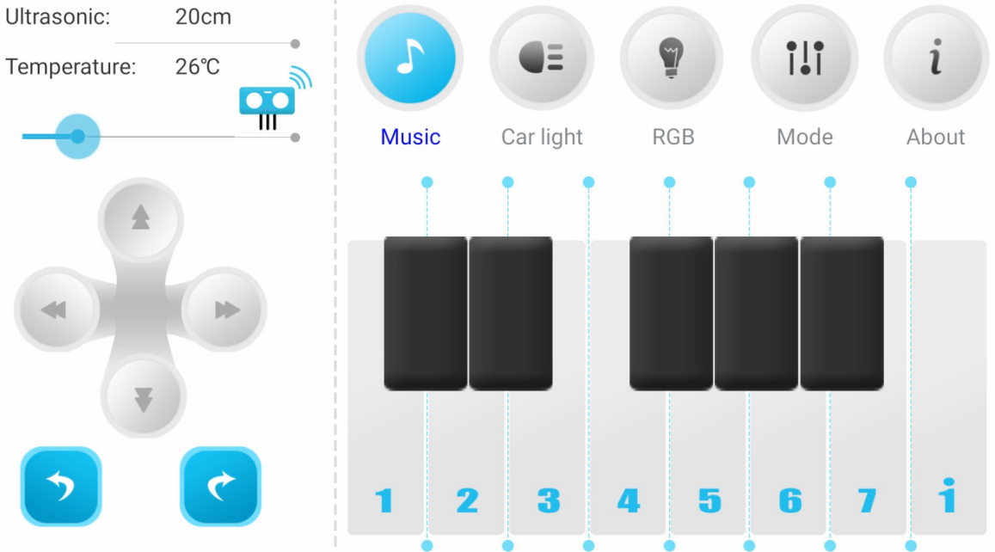
Connect bluetooth
3.4 The phone will automatically connect to the Bluetooth near the car. If there is no automatic connection, you need to click 【CONNECT】on the APP interface. As shown in Figure 3-3. Then, Bluetooth can be successfully connected, and the APP will enter the interface as shown below. As shown in Figure 3-4.
Figure 3-3
Figure 3-4
Yahboom

Slide 8
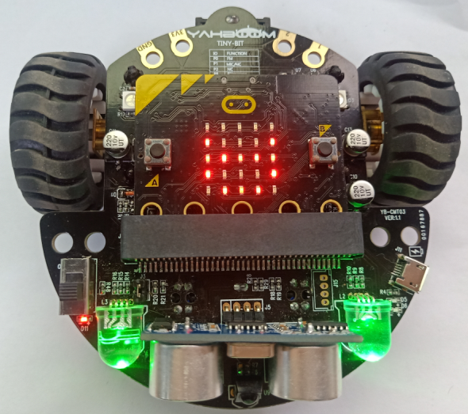
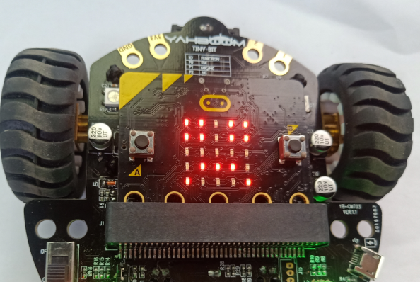
Connect bluetooth
After the Bluetooth is connected successfully, the pattern shown in Figure 3-5 will be displayed on the dot matrix of the Tiny-bit, and then the green RGB light will be illuminated. After waiting for the green RGB searchlight to be lit, we can start controlling the car.
If the Bluetooth is disconnected, a pattern of crying faces will appear on the dot matrix of the Tiny-bit car, as shown in Figure 3-6 below.
Figure 3-5
Figure 3-6
Yahboom

Slide 9
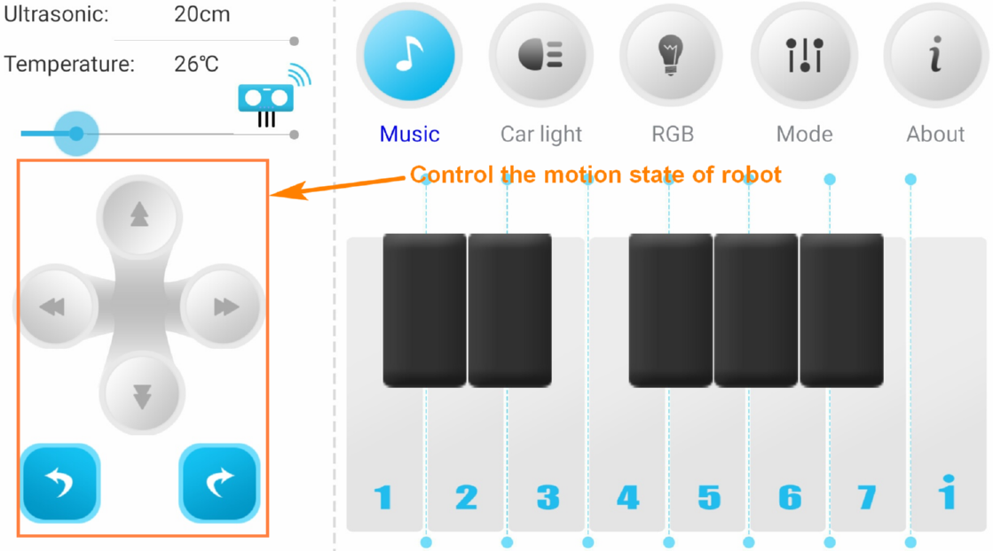
About APP
4. APP interface:
4.1 Basic :
Yahboom

Slide 10
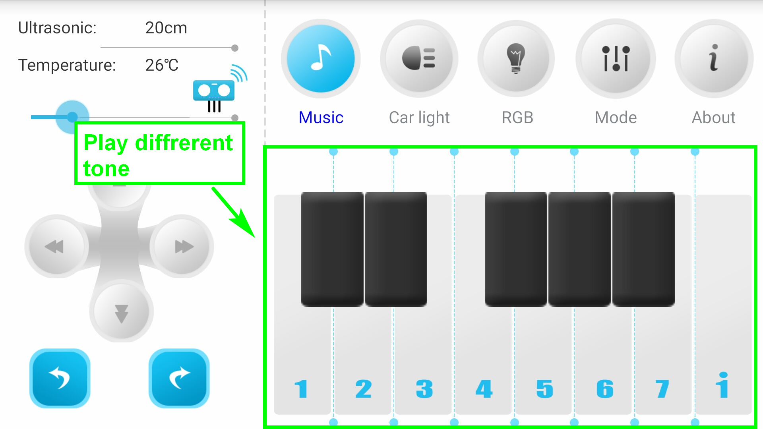
About APP
4.2 Music
Yahboom

Slide 11
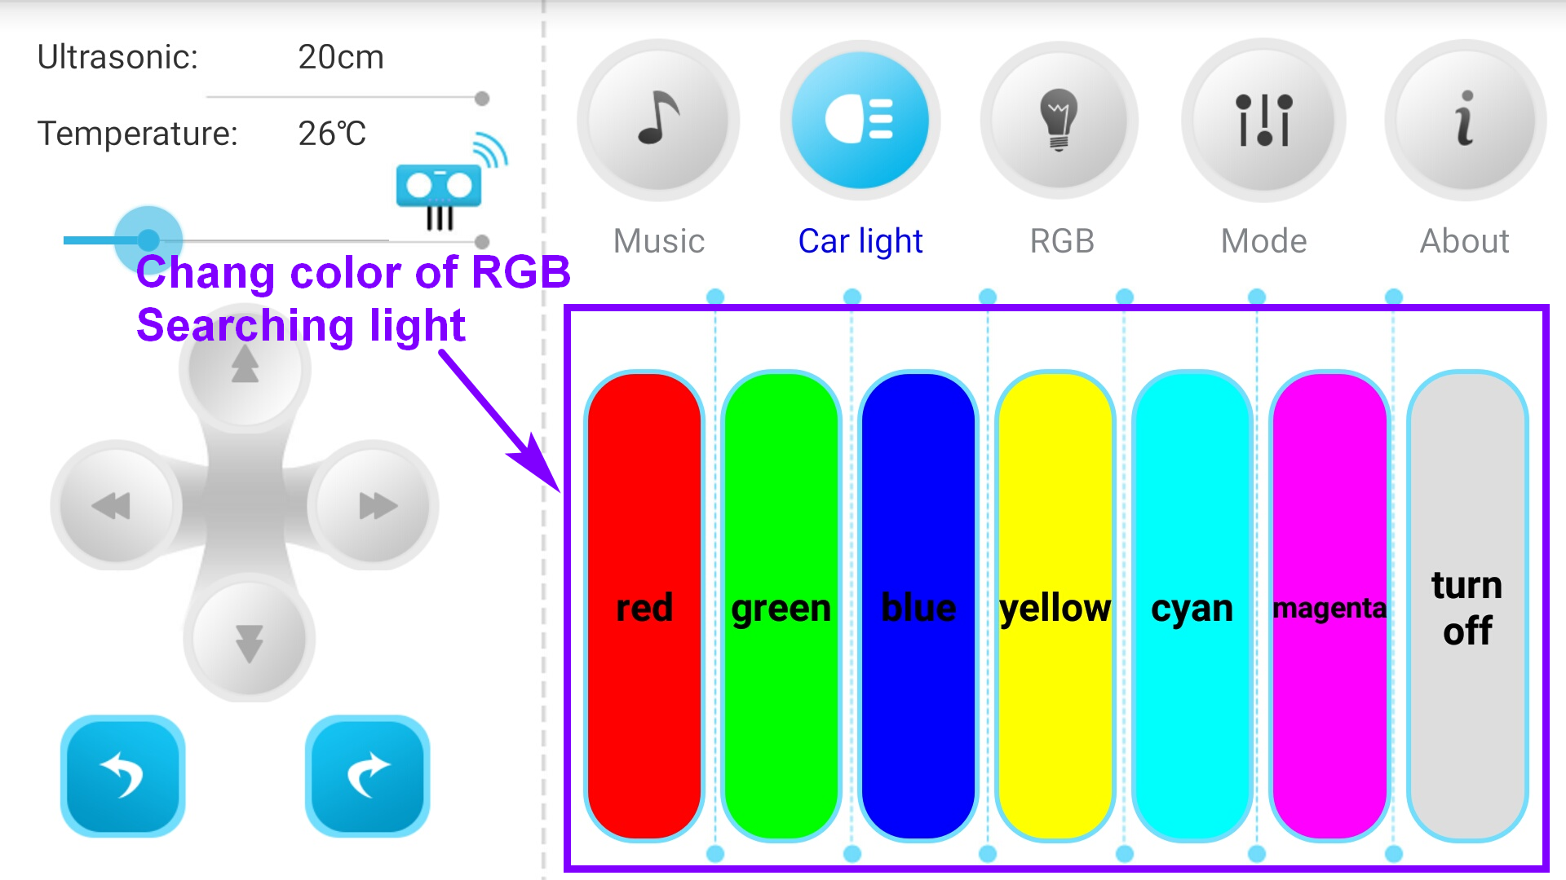
About APP
4.3 Car Lights
Yahboom

Slide 12
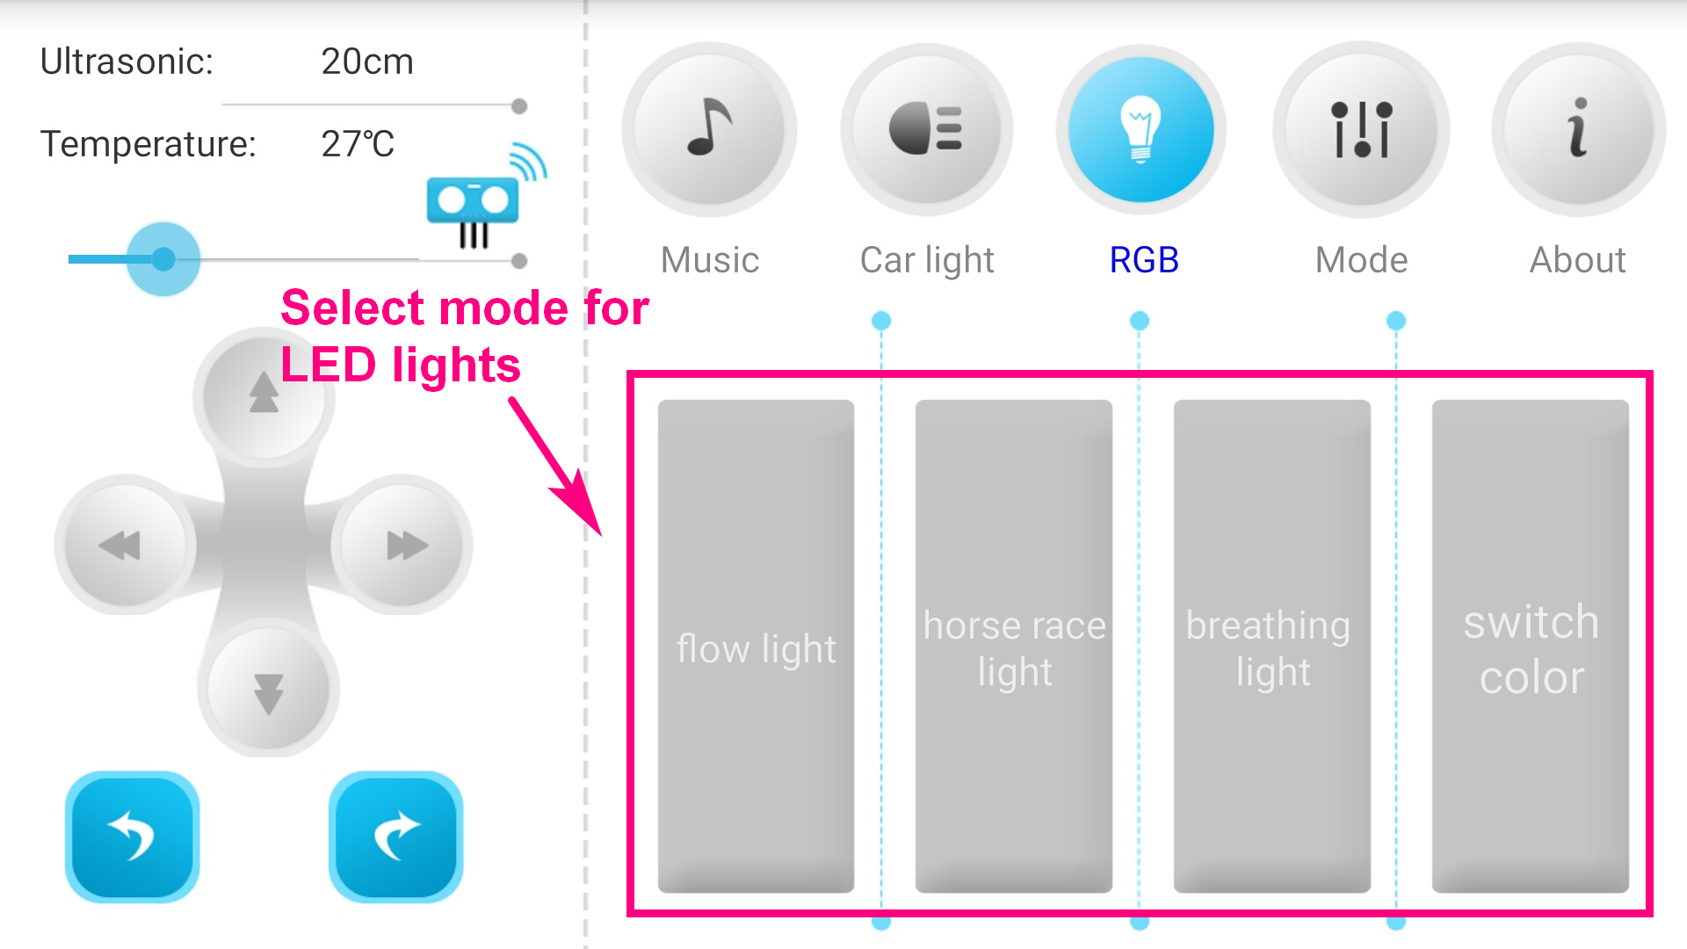
About APP
4.4 RGB lights
Yahboom

Slide 13
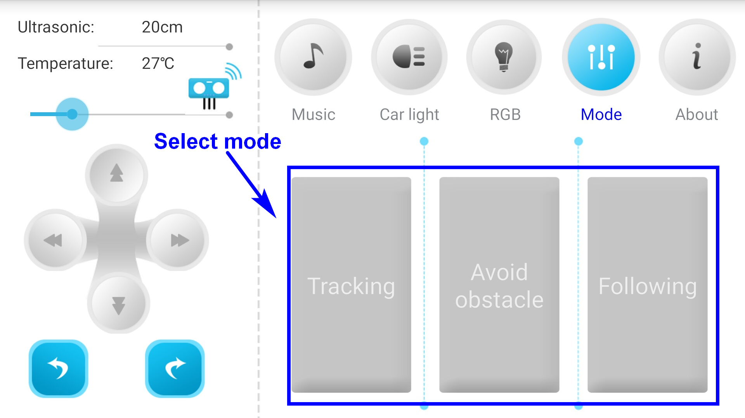
About APP
4.5 Mode
Yahboom

Slide 14
Inspire Creativity Embrace Innovation
Thank you!!!

